Slide 1
Capstone
presentation

Slide 2
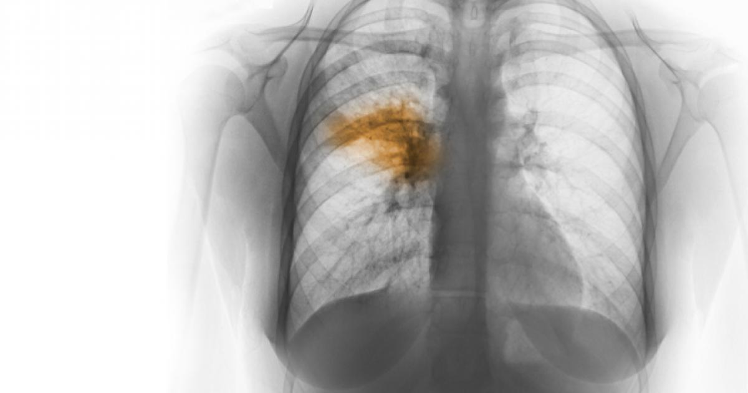

Slide 3
OVERVIEW OF PNEUMONIA
The single most significant bacterial cause of death in children worldwide is pneumonia. In 2017, pneumonia killed 808,694 children under the age of 5, accounting for 15 percent of all deaths by children under five. Children and families worldwide are afflicted by pneumonia, but it is most common in South Asia and sub-Saharan Africa. It can be avoided with easy procedures and managed with low-cost, low-tech treatment and care.

Slide 4
PROBLEM STATEMENT
In this project, we analyze data with the knowledge of EDA. We build a detection model and present our findings based on the evaluations with the RSNA Pneumonia Detection Challenge dataset.

Slide 5
DATA DESCRIPTION
RSNA Pneumonia dataset consists of 29684 thousand images. All the images are in Dicom format. There are 3000 images for testing and the remaining for training.
Dicom images: The images are in a particular format called DICOM files (*. dcm). They contain a mix of header metadata as well as pixel data underlying raw image arrays.

Slide 6
There are three classes in the dataset - Normal, Not normal/No opacity, and Lung opacity.
Normal class indicates there is no anomaly in the lungs.
Not normal/No opacity demonstrates to those who do not have pneumonia, but the image still has some abnormality. Sometimes, this finding could mimic the appearance of the right pneumonia.
Lung opacity class indicates there is definite pneumonia in the lungs.

Slide 7
The train labels file consists of the bounding box coordinates belonging to each image. Bounding box coordinates are given in the following format:
• x -- the upper-left x coordinate of the bounding box.
• y -- the upper-left y coordinate of the bounding box.
• width -- the width of the bounding box.
• height -- the height of the bounding box.
With these bounding box coordinates, the target column is provided, which discriminates classes into categories of 0 and 1.

Slide 8
EDA AND PREPROCESSING

Slide 9
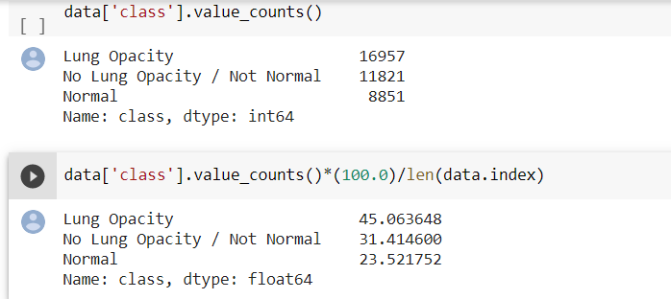
CLASSES

Slide 10
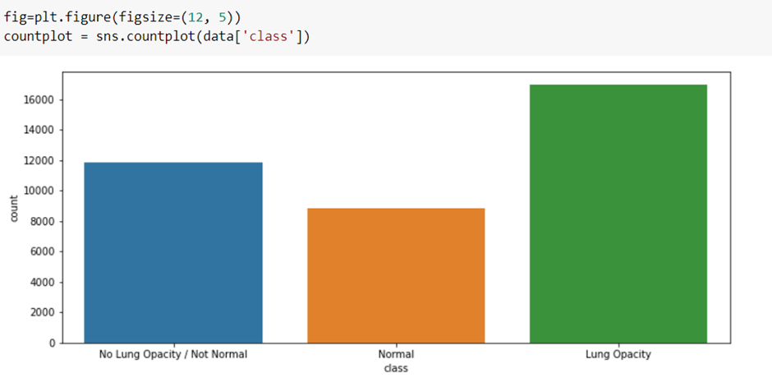

Slide 11
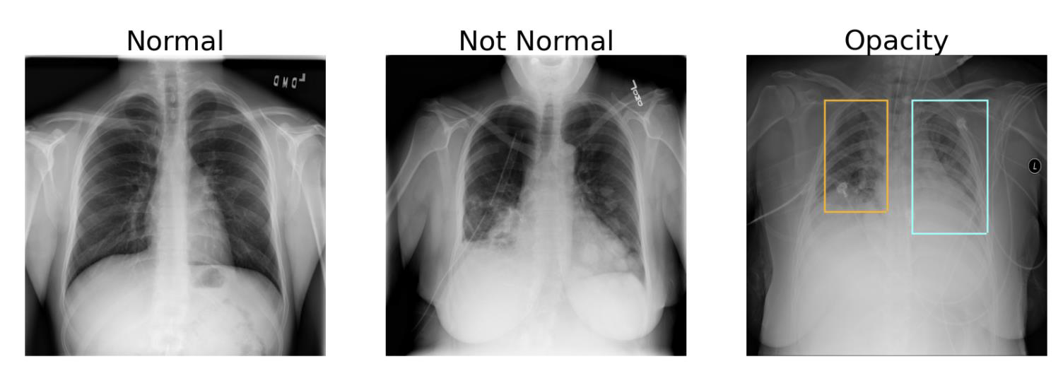

Slide 12
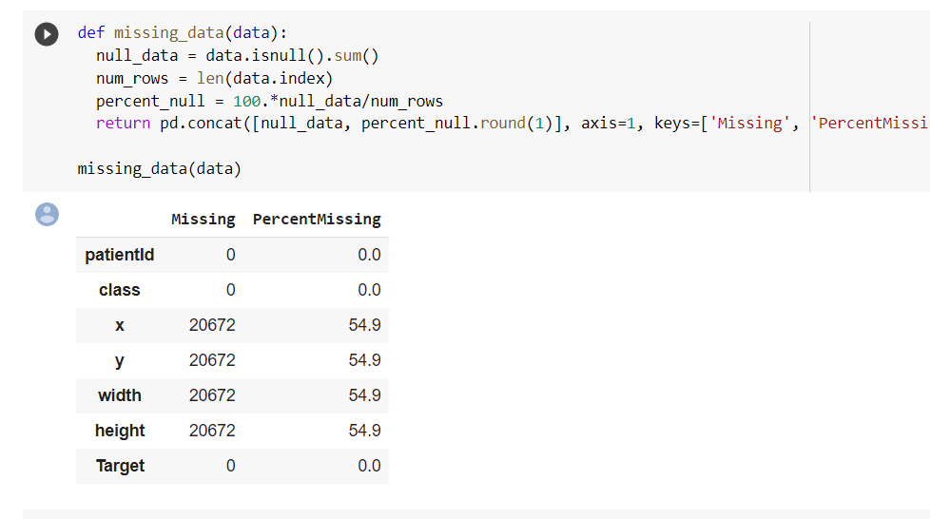
MISSING VALUES

Slide 13
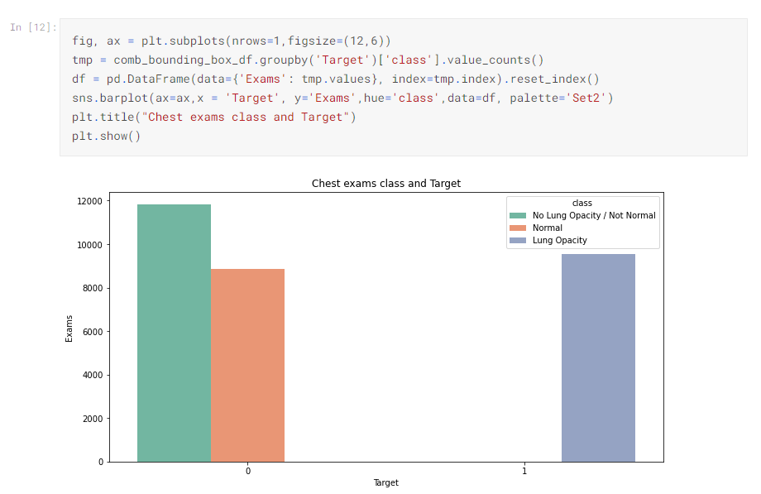
TARGET

Slide 14
META DATA

Slide 15
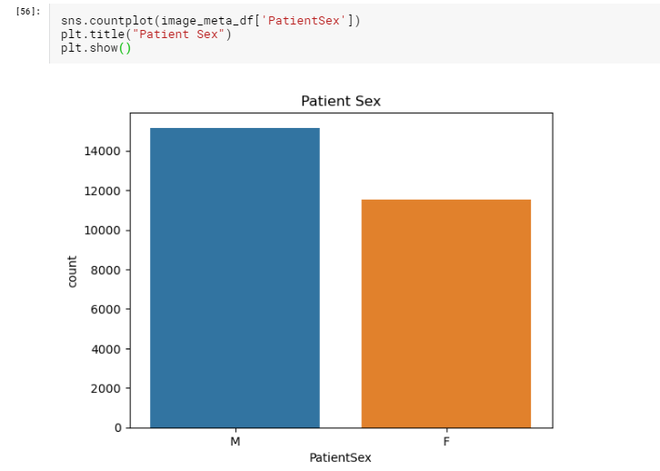

Slide 16
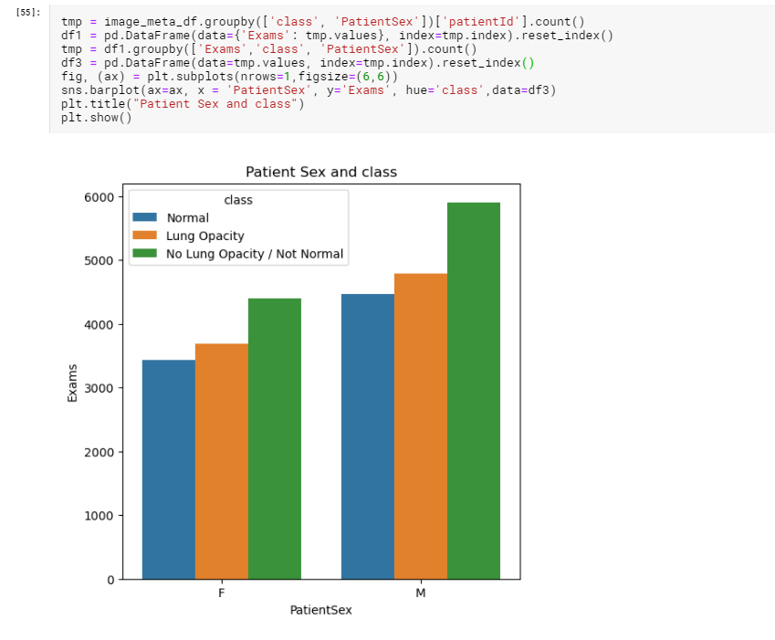

Slide 17
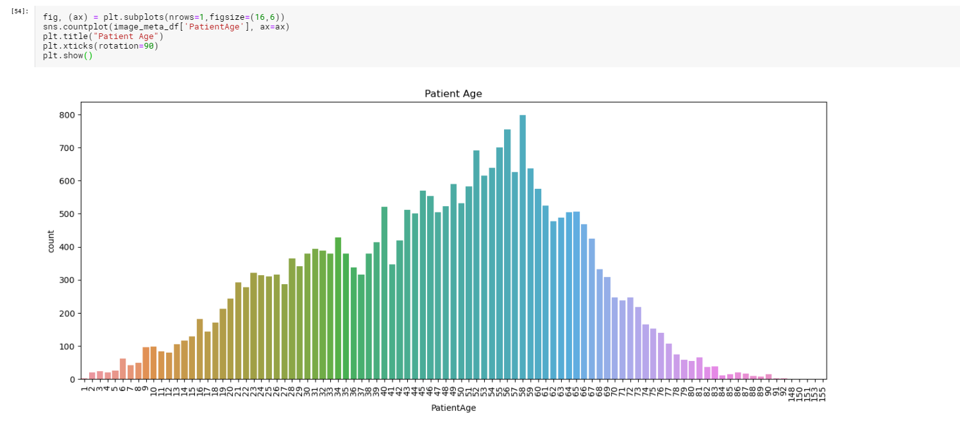

Slide 18
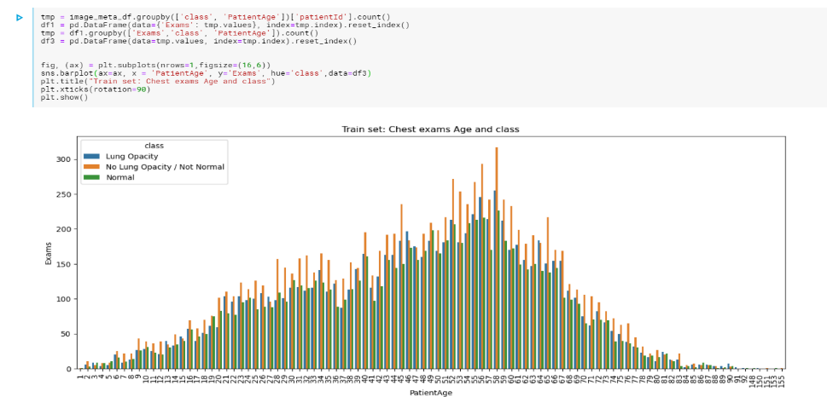

Slide 19
MODEL BUILDING

Slide 20
CNN CUSTOM MODEL WITH RESNET BLOCKS

Slide 21
NETWORK AND ARCITECTURE
The network consists of several residual blocks with convolutions and downsampling blocks with max pooling. At the end of the network, a single upsampling layer converts the output to the same shape as the input.
As the input to the network is 256 by 256 (instead of the original 1024 by 1024) and the network downsamples several times without any meaningful upsampling (the final upsampling is to match in 256 by 256 mask), the final prediction is very crude. If the network down samples four times, the final bounding boxes can only change with at least 16 pixels.

Slide 22
U-NET WITH MOBILENET BACKBONE

Slide 23
NETWORK AND ARCHITECTURE
This network consists of u-shaped architecture, as the name suggests. During the downsampling, features are generated gradually. Whereas on upsampling, the features are duplicated to that of the original image with mask segmentation.
This network takes an image input of 224*224 pixels with three channels red, green, and blue. It has around 3 million parameters. A standard convolution network consisting of repeated use of convolutions, each followed by a rectified linear unit (ReLU) and a max-pooling process, is the contracting part. The spatial information is decreased during the contraction, while feature information is increased. Via a series of up-convolutions and concatenations with high-resolution characteristics from the contracting path, the expansive path incorporates the function and spatial details.

Slide 24
DENSENET 121

Slide 25
NETWORK AND ARCHITECTURE
There are four Dense Blocks with varying layer numbers in each architecture. For instance, in the four dense blocks, DenseNet-121 has [6,12,24,16] layers. We can see that a 7x7 stage 2 Conv Layer followed by a 3x3 stride-2 MaxPooling layer consists of the first part of the DenseNet architecture. A Classification Layer that accepts the feature maps of all network layers to perform the classification follows the fourth dense block.
Downsampling and upsampling are added to the dense layers to learn the mask implementation of the given input images of 224*224 with three channels (RGB). This network has 6million parameters.

Slide 26
Mask RCNN

Slide 27
NETWORK AND ARCHITECTURE
The first step is to install the library. Installation involves cloning the GitHub repository and running the installation script on the workstation. Coco dataset pretrained weights are loaded to use for transfer learning.
Mask RCNN architecture consists of two stages,
Stage 1: The first stage consists of two networks, a backbone network (ResNet, VGG, Inception, etc.) and a network of regional proposals. To offer a set of region proposals, these networks run once per picture. Proposals for a region are regions in the function map that contain the object.
Stage 2: In the second stage, the network predicts bounding boxes and object class for each of the proposed region obtained in stage1. Each proposed region can be of different size, whereas fully connected layers in the networks always require a fixed size vector to make predictions. These proposed regions' size is fixed by using either RoI pool (which is very similar to MaxPooling) or the RoIAlign method. The RoIAlign layer's output is then fed into Mask head, which consists of two convolution layers. It generates a mask for each RoI, thus segmenting an image in a pixel-to-pixel manner.

Slide 28
EVALUATION

Slide 29
INITIAL RUNS

Slide 30
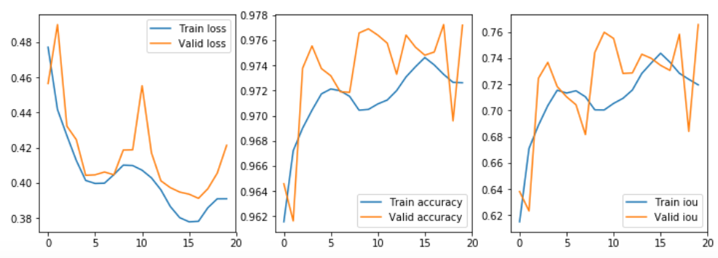
CNN CUSTOM MODEL WITH RESNET BLOCKS

Slide 31
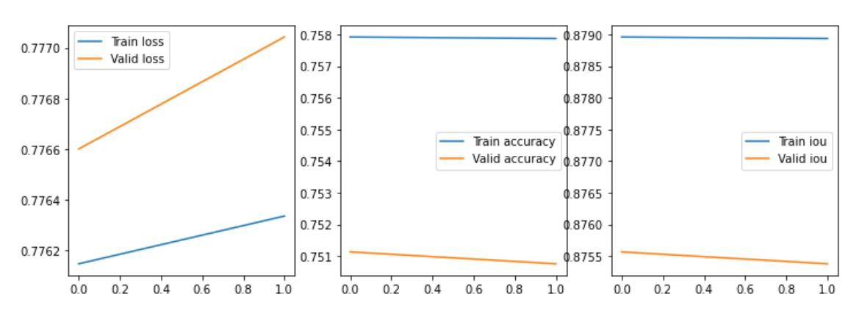
DENSENET 121

Slide 32
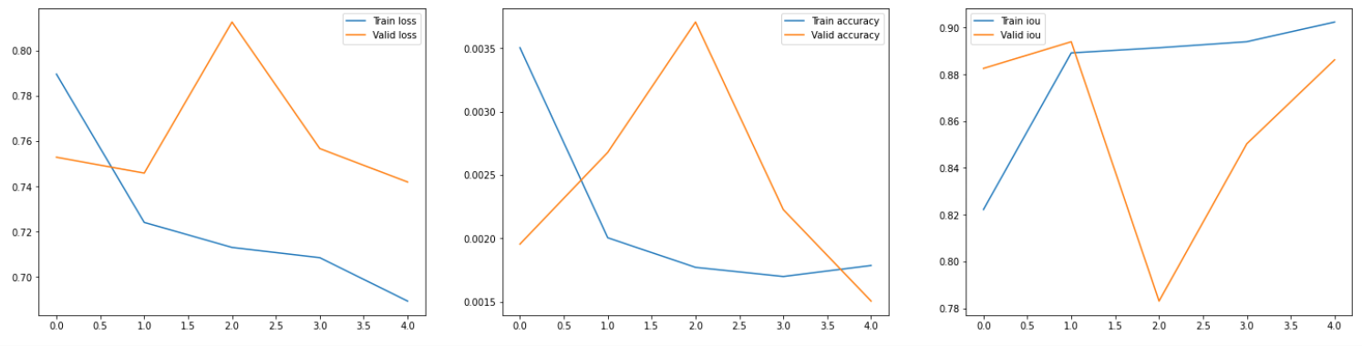
U-NET WITH MOBILENET BACKBONE

Slide 33
FURTHER RUNS WITH DIFFERENT HYPERPARAMETERS

